Slide 1
Introduction to Computers
Fo Guang Shan Sramanera School
Dera Gaon, Delhi

Slide 2
What is a Computer?
Can compute, like a calculator!
An electronic device that can process information from one form to another
Takes input, does a computation, generates output
Input and output can be in multiple forms (text, images etc)
A smartphone is also a computer!

Slide 3
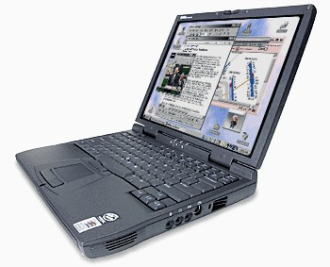
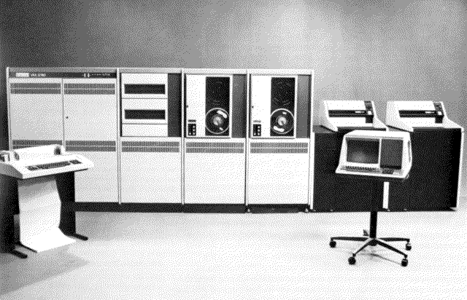
Types of Computers
Mainframes
Minicomputers
Personal Computers
Embedded Computers

Slide 4
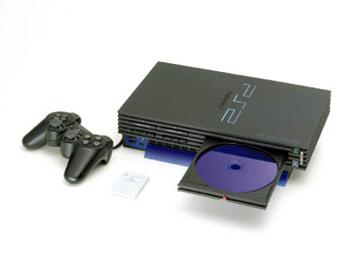
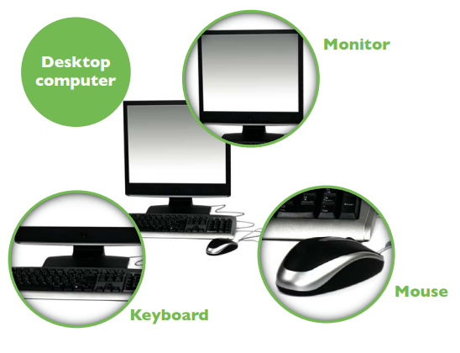
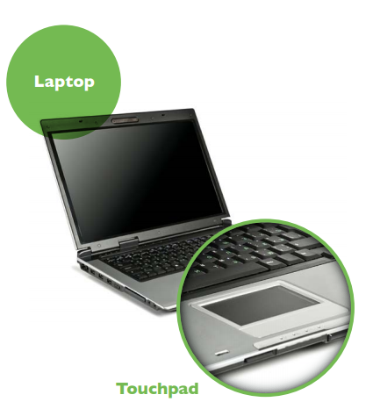
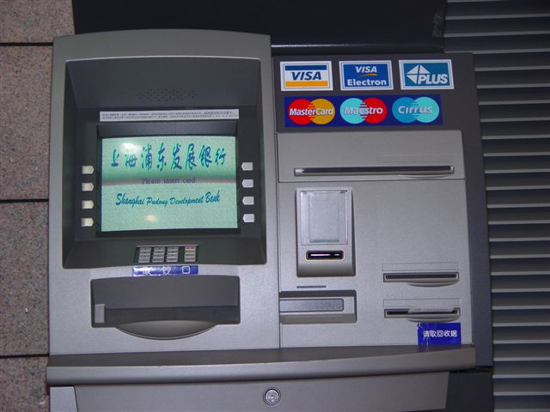
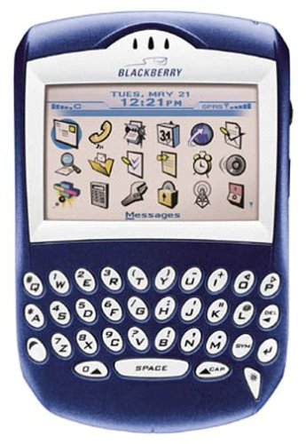
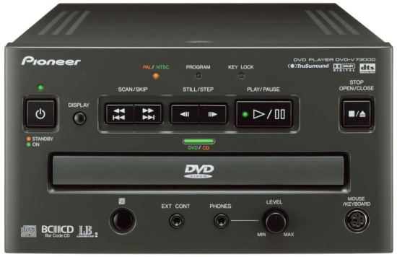
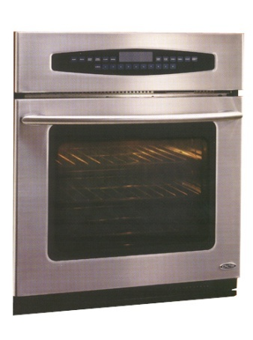
Types of Computers

Slide 5
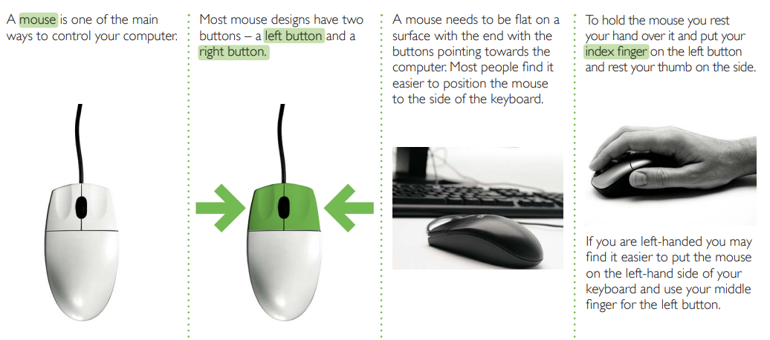
Using a mouse

Slide 6
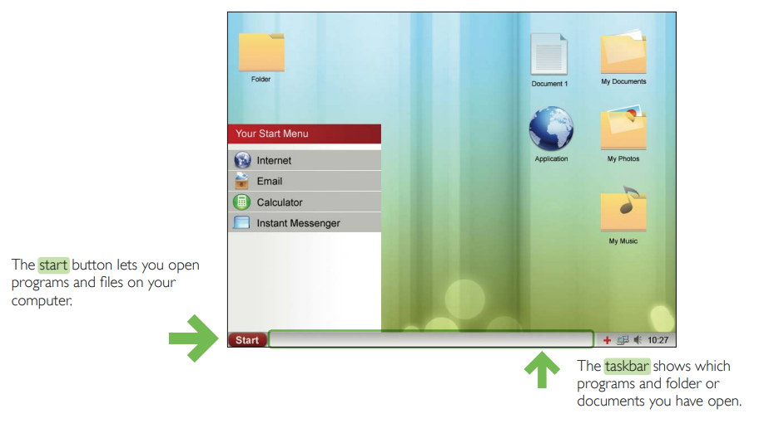
Desktop and icons

Slide 7
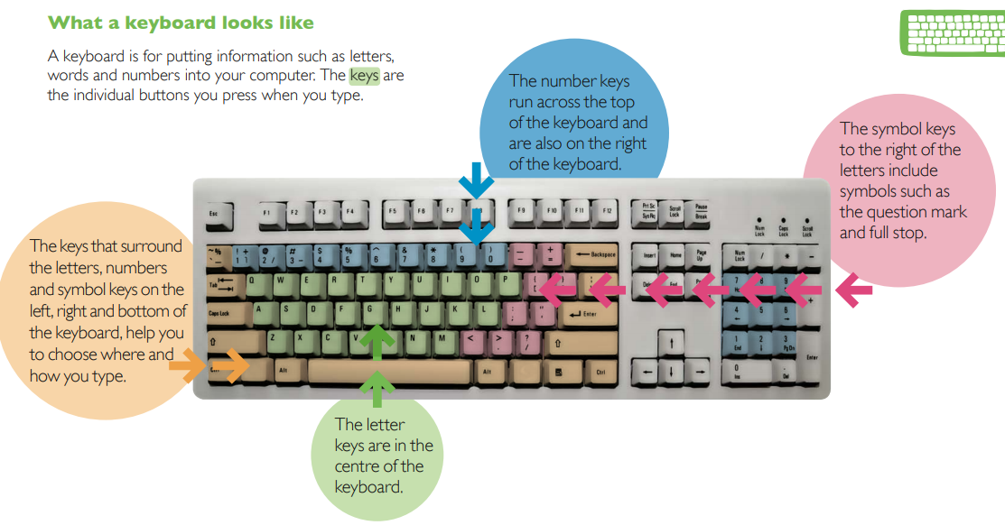
Using a keyboard

Slide 8
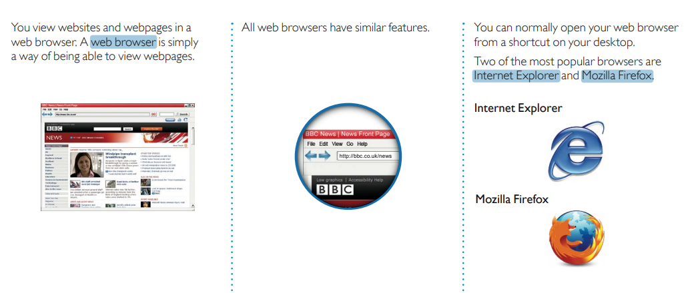
Internet: Web Browser

Slide 9
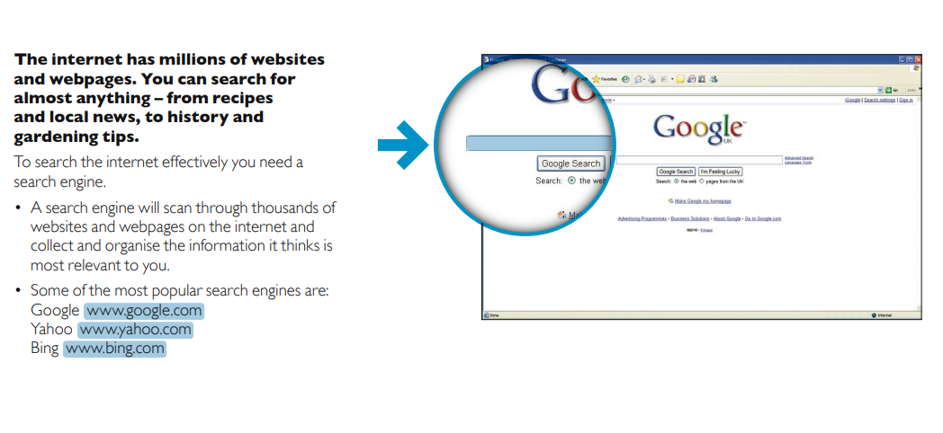
Internet: Search Engine

Slide 10
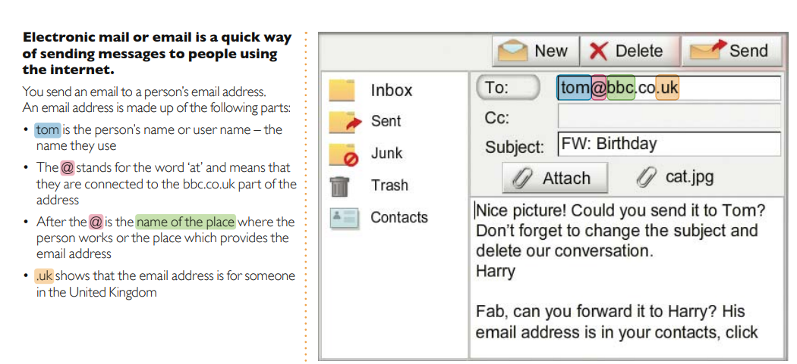
Internet: Email

Slide 11
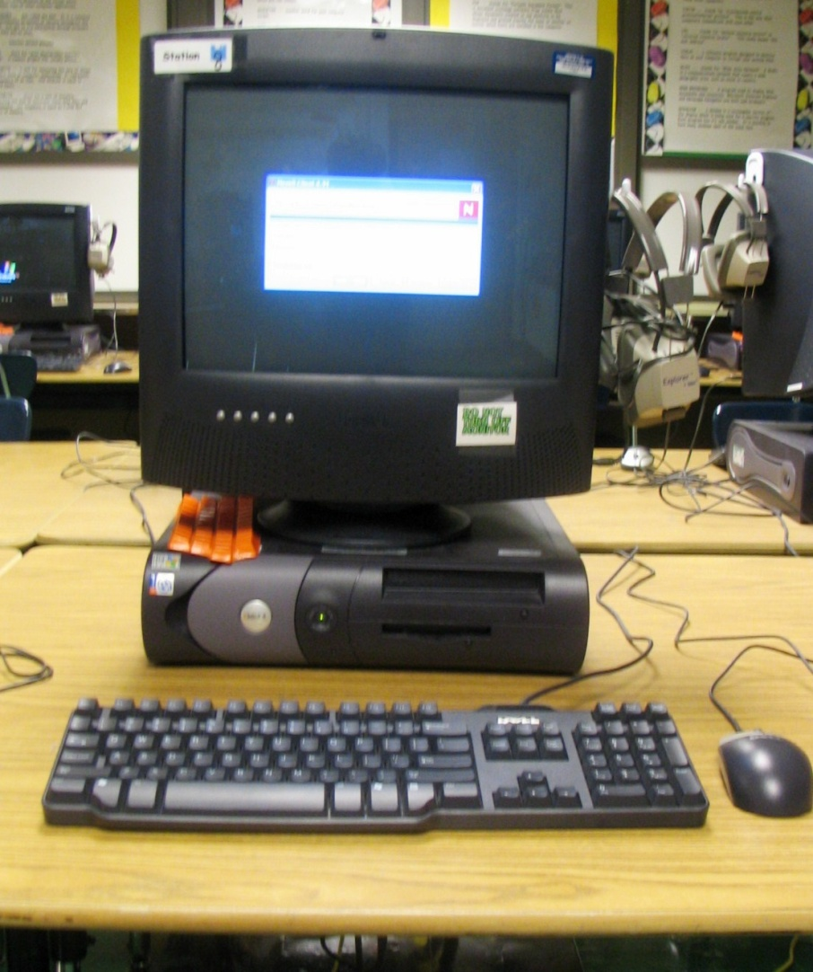
Parts of a Computer
Monitor
CPU (Central Processing Unit)
Keyboard
Mouse
Power Cord

Slide 12
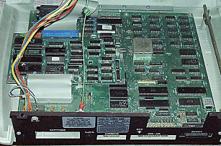
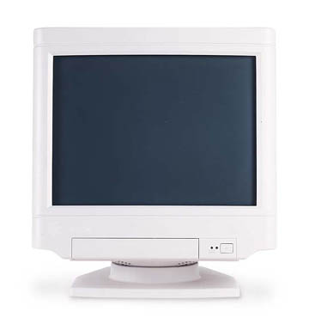
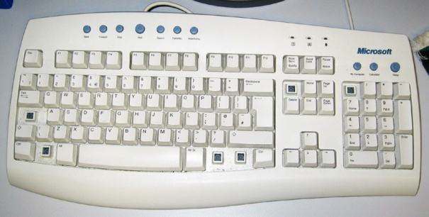
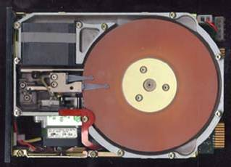

Slide 13
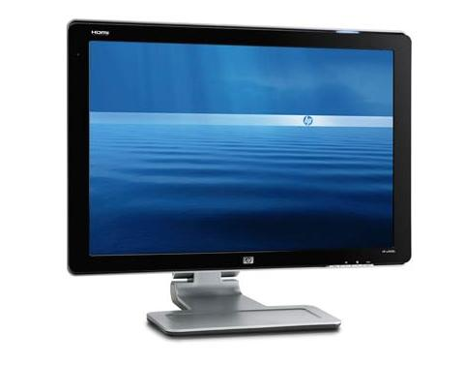
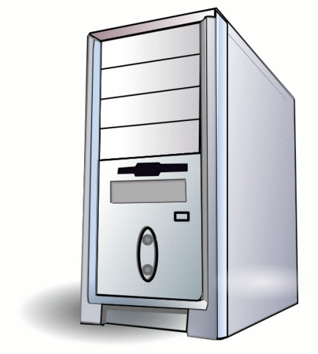
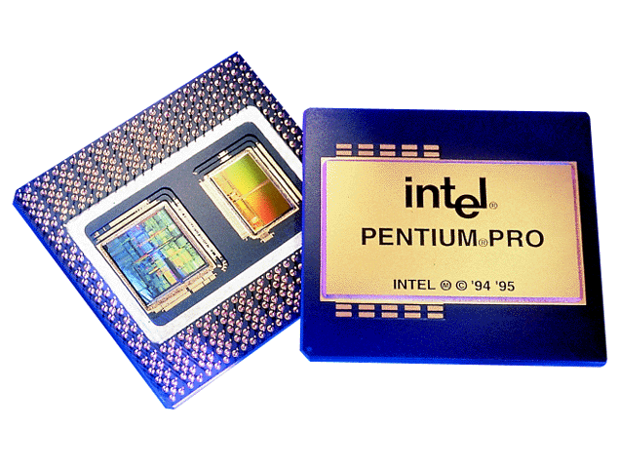
Monitor and CPU
Monitor looks like a TV, lets you see your work
CPU is the brains of the computer

Slide 14
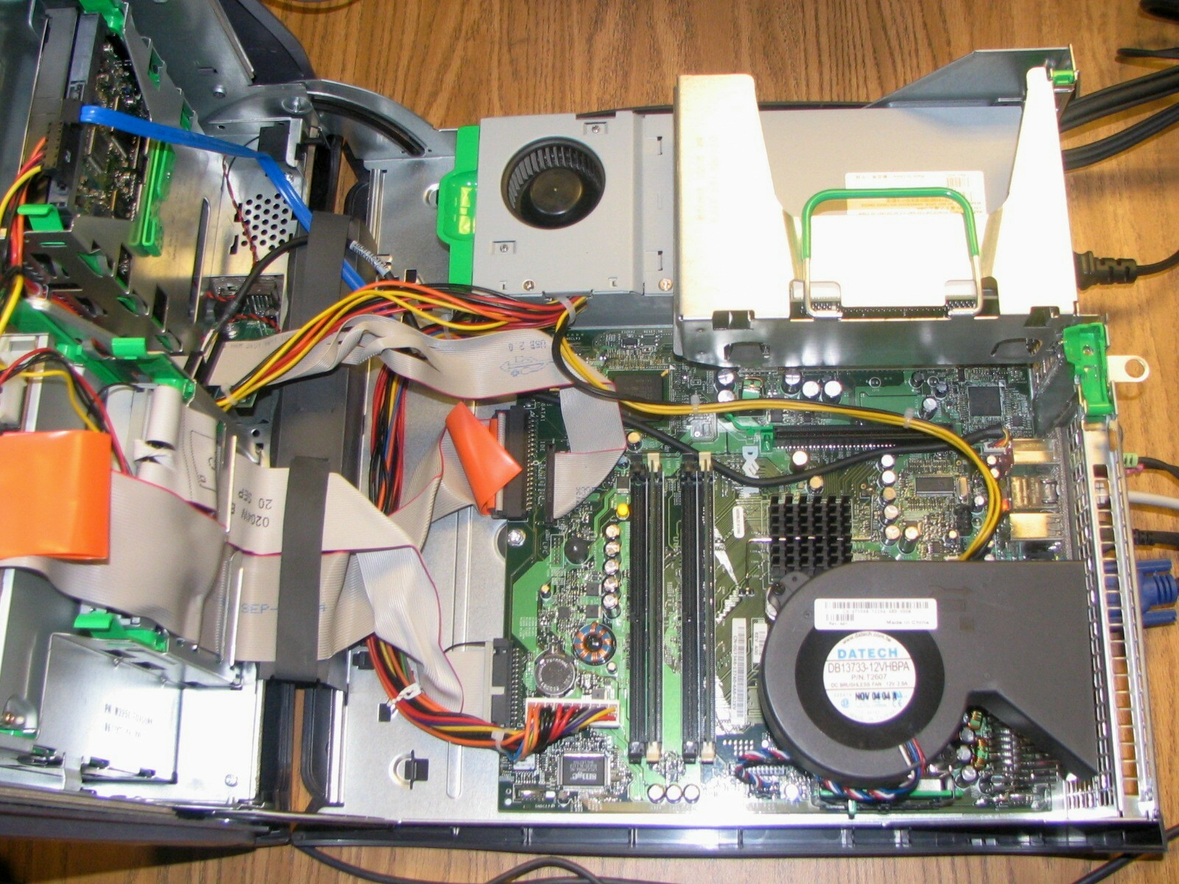
Inside a Computer
Hard Disk
Motherboard
Memory Card
Sound Card
Power Supply
Network Card

Slide 15
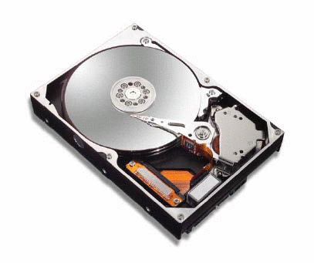
Hard Disk
Stores the data
Capacity can be 100GB, 250GB etc
Circular steel disk
Spins at 7200 rpm etc
Magnetic reading ‘head’ passes over it

Slide 16
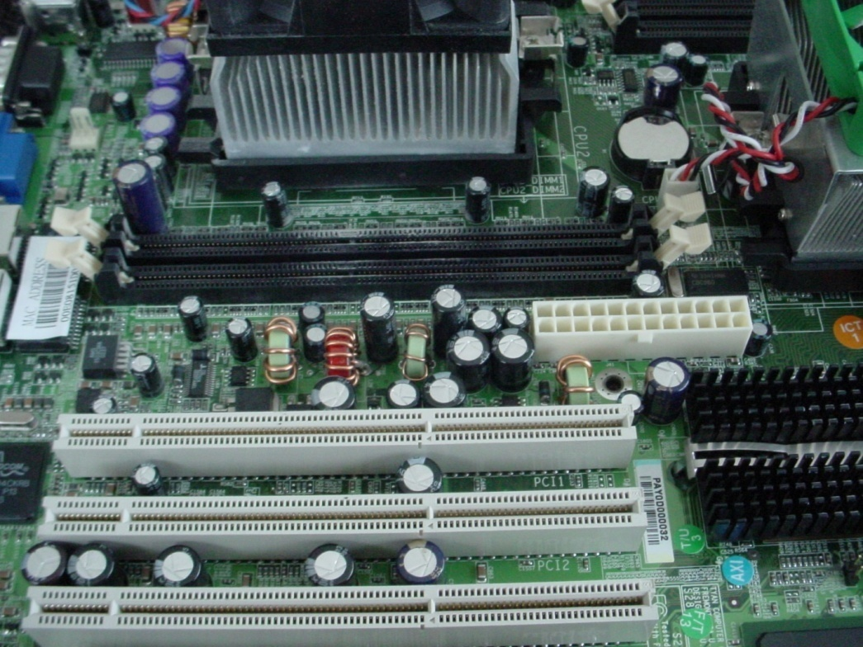
Motherboard
Main circuit board inside computer
Everything plugs into the motherboard
Ties everything together (memory, input, output)

Slide 17
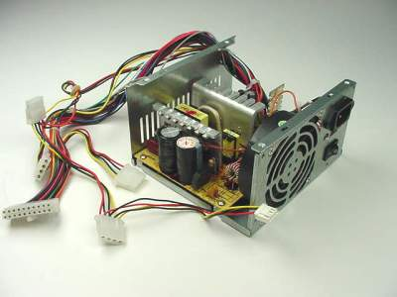
Power Supply
Converts AC to DC
Connects to power cord
Has fan to cool (prevent overheating)

Slide 18
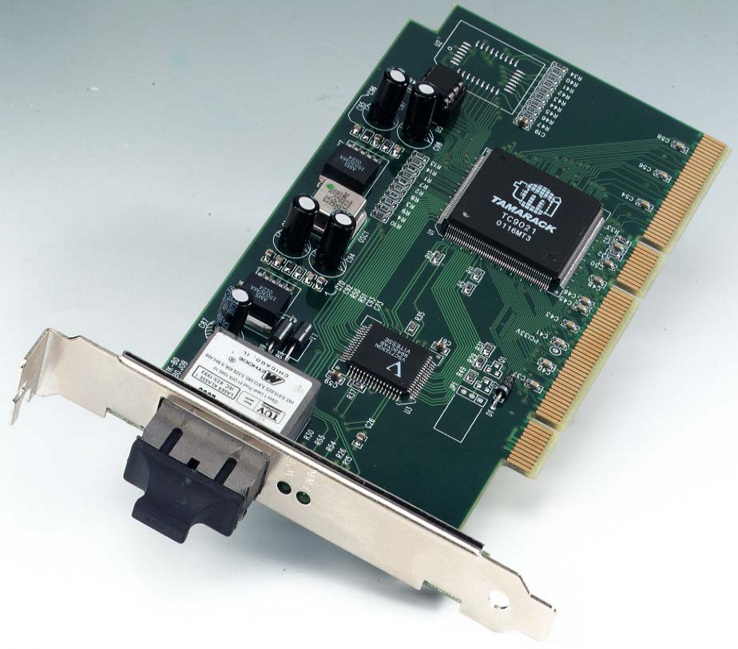
Network Card
Connects to Network Cable
Allows Computer to talk to other computers
Need it to connect to internet

Slide 19
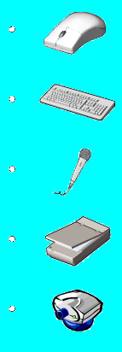
Input Devices
Mouse
Keyboard
Microphone
Scanner
Webcam

Slide 20

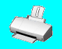
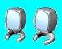
Output Devices
Monitor
Printer
Speaker/Headphone

Slide 21
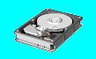
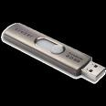


Storage Devices
Hard Disk
Flash Drive
CD-ROM
DVD-ROM

Slide 22
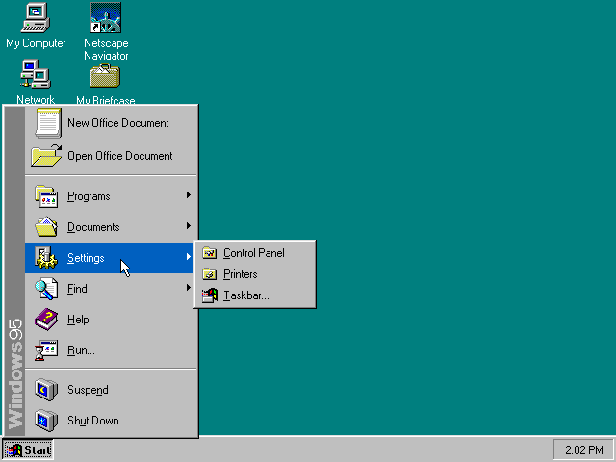
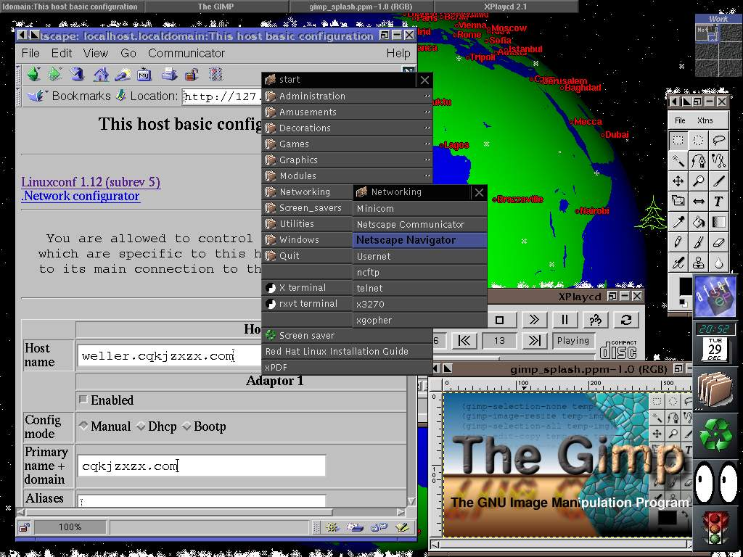
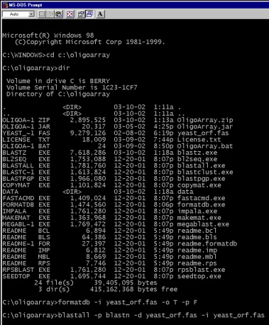
Operating System
Is the most important software on the computer
Controls and manages the hardware connected to your computer
Text-based (Linux) or graphics-based (Windows).

Slide 23
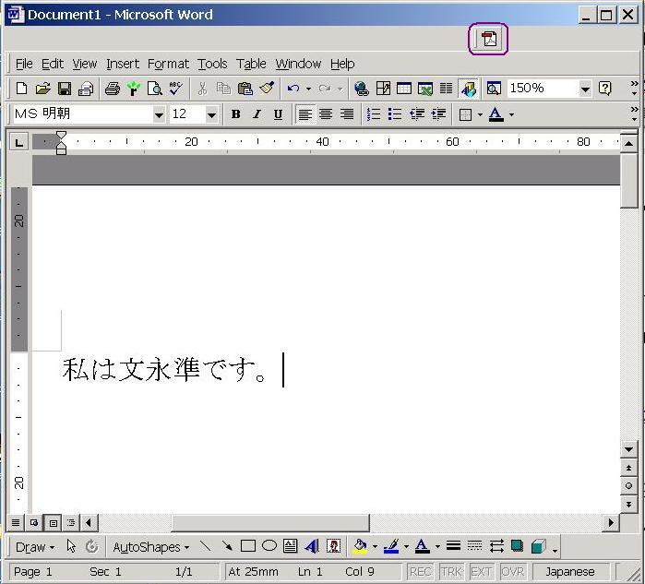
Programs
The hardware and the operating system together are referred to as a platform.
Programs, also called applications, use this platform to perform tasks.
There are many types of programs:
Word, Powerpoint, Excel etc : Perform tasks
Movie maker, MS Paint etc : Create media
Eclipse , Visual Studio: Write Programs

Slide 24


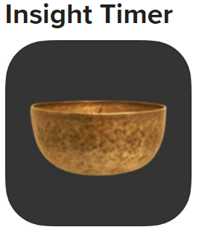
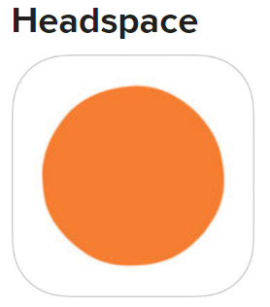
Android and iOS: Meditation apps
Android: Mobile phone operating system
Apps: meditation apps, Buddhist apps

Slide 25
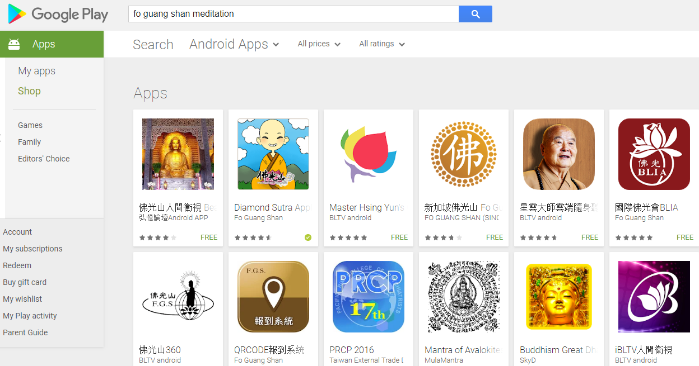
Fo Guang Shan and Buddhism apps
Go to Android play store
Search for Buddhism or Fo Guang Shan

